Slide 1
The AC/DC Framework
Analysis Concepts & Derivation Concepts for Analysis

Slide 2
Agenda
The Problem: Hardcoded ADaM Programs
The Analytical Data Model: Semantic Vocabulary
AC/DC Templates: Reusable Patterns (SDMX Cubes)
AC/DC Instances: Study-Specific Bindings
Three-Layer Resolution: Concept → ADaM Class → Study
Both Directions - Derivation Concepts & Analysis Concepts

Slide 3
The Problem
Why Current ADaM and Output Programming Doesn't Scale

Slide 4
Everything is Hardcoded
A typical ANCOVA program:
proc mixed data=adam.adqsadas;
where PARAMCD="ACTOT11" and EFFFL="Y";
model CHG = BASE SITEID TRTP;
run;
What's embedded in the code:
Dataset name: adqsadas
Variable names: CHG, BASE, TRTP, SITEID
Filter conditions: PARAMCD, EFFFL values
Different parameter? → Copy-paste, change values
Different study? → Rewrite everything

Slide 5
An automated approach – tied to specific language
YAML + R Code References
table:
name: ADSL
filter_domain:
- dm: '!is.na(AGE)' # R syntax
column_action:
AGE_GRP1:
code_id: "age_group_01.R" # code file
Domain-Specific Language (DSL)
if DM.DTHFL = 'Y'
and the latest of
([ADSL.LSTALVDT + 1 day, ADSL.DTHDTC])
is not later than 2023-07-01,
then set to the latest of
([ADSL.LSTALVDT + 1 day, ADSL.DTHDTC]),
else set to blank.
Example from PHUSE EU 2025, Paper SM04
Matthew Phelps, Nicolai Skov Johnsen, Novo Nordisk
Example from PHUSE EU 2023, Paper DH12
Kang Zhao, AstraZeneca
Common Problems:
Clever solutions, but proprietary: Each company invents its own format
Platform-specific: Tied to R ecosystem or custom interpreters
Spec ≠ Code: Logic hidden in external code-files (YAML) or requires custom parser (DSL)
Not portable: Can't be shared across companies or tools
Missing intent: Tells us HOW to compute, but not the analytical purpose

Slide 6
The AC/DC Solution
Separating "What" from "How" from "Where"

Slide 7
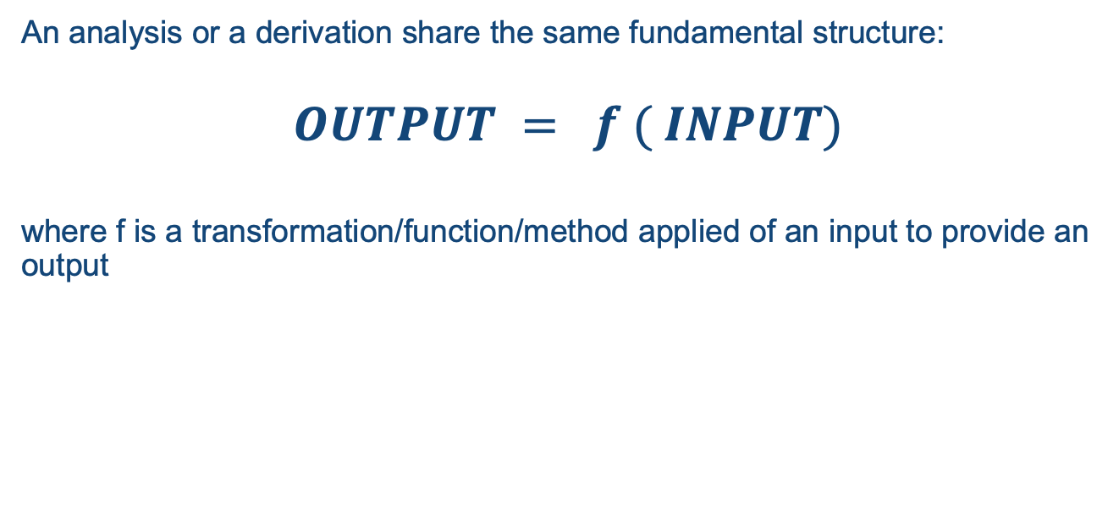
Derivation and Analysis - Functions
An analysis or a derivation share the same fundamental structure:
$$OUTPUT = f ( INPUT)$$
where f is a transformation/function/method applied of an input to provide an output

Slide 8
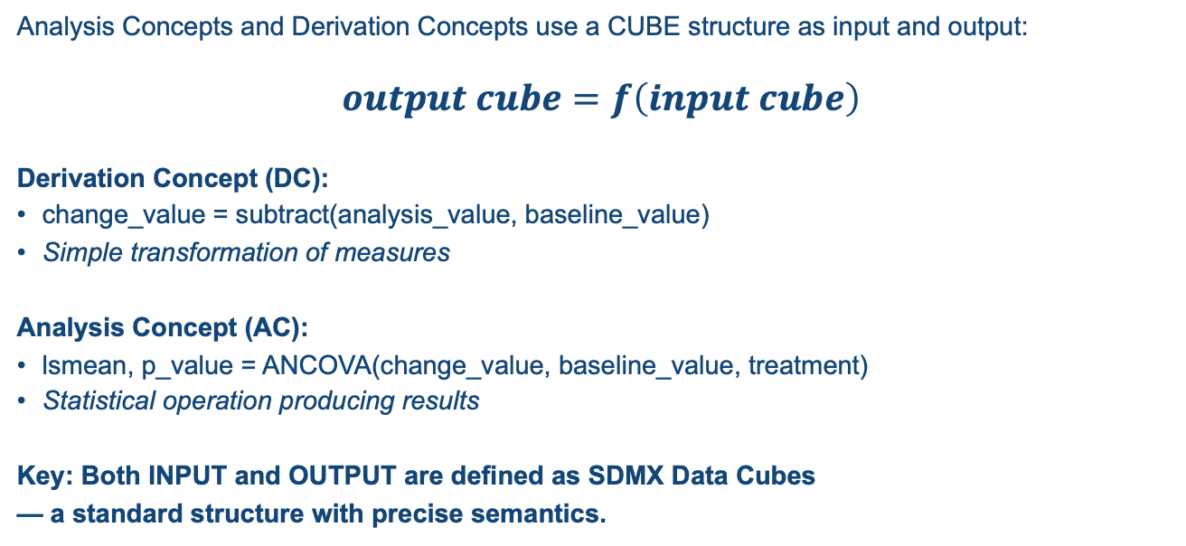
The AC/DC Model: A Function Over Data Cubes
Analysis Concepts and Derivation Concepts use a CUBE structure as input and output:
$$output cube=f\left(input cube\right)$$
Derivation Concept (DC):
change_value = subtract(analysis_value, baseline_value)
Simple transformation of measures
Analysis Concept (AC):
lsmean, p_value = ANCOVA(change_value, baseline_value, treatment)
Statistical operation producing results
Key: Both INPUT and OUTPUT are defined as SDMX Data Cubes
— a standard structure with precise semantics.

Slide 9
The SDMX Data Cube: Three Component Types
Each component has a defined role that determines how it participates in operations:
DIMENSION
Identifies the observation — the “coordinates” in the cube
Examples: subject, visit, parameter, treatment
MEASURE
The observed/computed value at that point — numeric quantities
Examples: analysis_value, baseline_value, change_value, lsmean, p_value
ATTRIBUTE
Metadata that qualifies but does not identify — context and flags
Examples: population_flag, baseline_flag, unit, reason_for_exclusion
Why SDMX? ISO standard (17369) for statistical data exchange.
The roles are not arbitrary — they have standardized meaning across tools and platforms.

Slide 10
Slices: Subsetting the Cube
A Slice fixes certain dimensions or attributes to create a subset of the cube.
Full Cube (all data):
Dimensions: subject, visit, parameter, treatment
Measures: analysis_value, baseline_value, change_value
Attributes: population_flag, baseline_flag
Slice (analysis context):
parameter = “ADAS-Cog(11)”
visit = “Week 24”
population_flag = “Y” (efficacy population)

Slide 11
Machine-Executable: Roles Define Operations
Each SDMX role has inherent computational semantics — no pseudo-code needed:
SDMX Role → Code Generation Operation
DIMENSION → GROUP BY / BY statement / stratification axis
MEASURE (input) → Function arguments / MODEL variables
MEASURE (output) → Return values / result columns
ATTRIBUTE (slice) → WHERE clause / filter condition
Why This Works:
Declarative, Not Procedural: You specify the structure of input/output, not the steps
Platform Independent: Same cube definition generates SAS, R, or Python
Unambiguous Semantics: A generator knows exactly what to do with DIMENSION vs MEASURE
ISO Standardized: SDMX (ISO 17369) is used by statistical agencies worldwide
The cube structure IS the specification. Roles carry meaning; a generator traverses the structure and emits code.

Slide 12
Three-Layer Architecture
Layer 1: AC/DC Instance – the derivation/analysis logic
"What am I deriving/analyzing"
template based on semantic concepts (change_value, baseline_value)
references the Analytical Data Model via IS_A relationships
Layer 2: Analytical Data Model
”Definitions of analytical concepts and their relationships, if any
study-independent
generic definition of change_value, baseline_value, treatment, LSMean, p-value, min, max, mean…
Layer 3: Implementation/presentation layer
"Where is my data?" — Study-specific
How does my presentation layer relate to the Analytical Data Model – the mapping
change_value ← CHG ← ADQSADAS.CHG,
treatment ← TRT01P ← ADQSADAS.TRT01P
Same analysis, different study? Only Layer 3 changes.

Slide 13
AC/DC Templates: Reusable Patterns
Templates assign SDMX cube roles to concepts:
Template: T_DC_ChangeFromBaseline
Input: subject, visit, parameter (dimension); analysis_value, baseline_value (measure)
Output: change_value (measure)
Method: target = analysis_value - baseline_value
Template: T_AC_ANCOVA
Input: subject (dimension); treatment, site (dimension/factor)
Input: change_value (measure/dependent); baseline_value (measure/covariate)
Output: lsmean, se, ci_lower, ci_upper (measure)
Key insight:
Concepts come from Analytical Data Model
Roles (dimension, measure, factor, dependent) come from Template

Slide 14
The framework - conceptually
Analysis/derivation specification
Analytical Data Model
Standard/Study Implementation
AC/DC
ADaM Sponsor Variable
Dimension
is_a
Concept
is_a
ADaM Standard Variable
Input Cube
ADaM Sponsor Variable
ADaM Sponsor Dataset
ADaM Standard Variable
ADaM Sponsor Variable
Method
Measure
Concept
Output Cube
Dimension Component
Slice
Attribute
Concept
Analysis Output Dataset
Measure Component
Attribute Component

Slide 15
The Analytical Data Model
The semantic vocabulary — concepts that AC/DCs reference:
Concepts (standard-agnostic):
subject, parameter, visit, treatment, site
analysis_value, baseline_value, change_value
population_flag, baseline_flag
Semantic relationships:
change_value derived_from (analysis_value, baseline_value)
baseline_value identified_by (subject, parameter, baseline_flag)
No cube roles here — roles are assigned by Templates:
The Template's SDMX cube decides whether 'treatment' is a dimension or a factor, whether 'change_value' is a dependent measure or an output.

Slide 16
From Template to Study
AC/DC Instances & Resolution

Slide 17
AC/DC Instances: Study-Specific Bindings
An Instance instantiates a Template for a specific context:
Instance: S_AC_001
Based on: T_AC_ANCOVA (template)
Cube Slice (fixed values via attributes):
parameter = "ADAS-Cog(11)"
visit = "Week 24"
population_flag = "Y" (efficacy population)
This is how AC/DC Instances work:
The Template defines the cube structure (what dimensions and measures exist)
The Instance creates a Slice by fixing specific values for the analysis context
Same Template, different Slice = different analysis (e.g., Week 12 instead of Week 24)
The instance references concepts from Analytical Data Model:
change_value IS_A concept (template assigns role: dependent)
baseline_value IS_A concept (template assigns role: covariate)
treatment IS_A concept (template assigns role: factor)
Template defines structure; Instance binds to specific context.

Slide 18
Resolution: Concept → ADaM Class → Study
Instance S_AC_001 specifies:
formula: change_value ~ baseline_value + site + treatment
filter: parameter="ADAS-Cog(11)", population_flag="Y"
Layer 2 (ADaM Standard mapping):
change_value → CHG
baseline_value → BASE
treatment → TRT01P
site → SITEID
parameter → PARAMCD
Layer 3 (Sponsor ADaM mapping):
CHG → ADQSADAS.CHG
BASE → ADQSADAS.BASE
TRT01P → ADQSADAS.TRT01P
Resolved: model CHG ~ BASE + SITEID + TRT01P from ADQSADAS

Slide 19
Both Directions
Derivation Concepts & Analysis Concepts

Slide 20
Derivation Concepts (DC): ADaM Variable Derivations
Instead of 500-line monolithic programs:
CHG = AVAL - BASE; /* buried in code */
Define atomic, composable derivations:
DC Instance: S_DC_004 (based on T_DC_ChangeFromBaseline)
Input concepts: analysis_value, baseline_value
Output concept: change_value
Formula: target = analysis_value - baseline_value
Depends on: S_DC_001 (AVAL), S_DC_003 (BASE)
Benefits:
Explicit dependency graph
Reusable across studies (same template, different Layer 3)
Automatic traceability

Slide 21
Analysis Concepts (AC): Complex Analyses
For statistical operations beyond simple derivations:
AC Instance: S_AC_001 (based on T_AC_ANCOVA)
Template's cube roles map to statistical operations:
Concept with role=dimension (factor) → CLASS variables
Concept with role=measure (dependent) → MODEL left side
Concept with role=measure (covariate) → MODEL right side
Concept with fixed value (slice) → WHERE clause
Output cube contains results:
lsmean, lsmean_se, ci_lower, ci_upper, p_value
Same template handles ADAS-Cog, MMSE, any efficacy endpoint — only the slice changes.

Slide 22
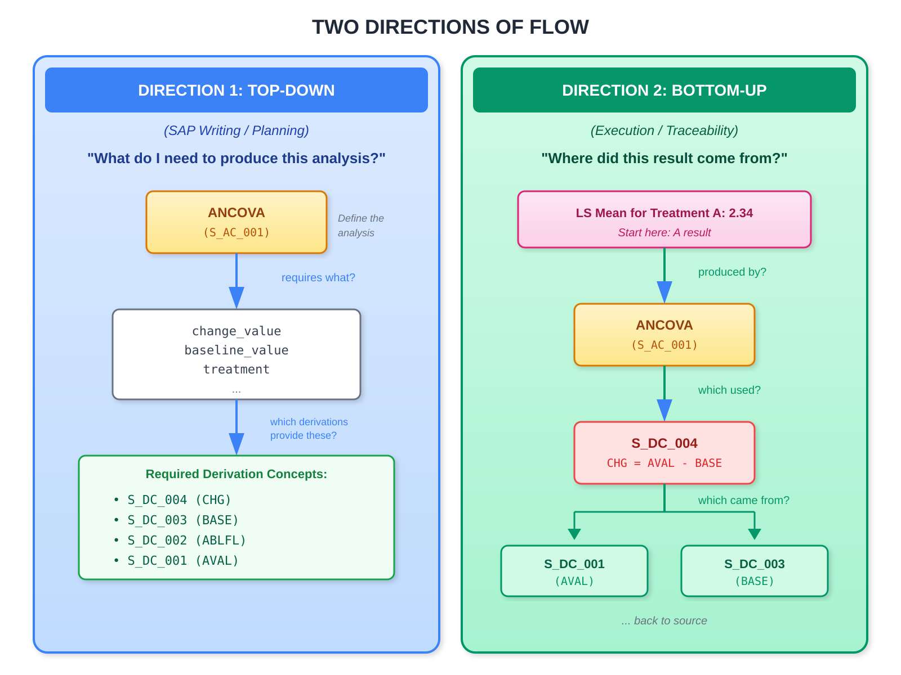
Bidirectional Traceability
At SAP Writing Time (Top-Down):
1. Author defines: "ANCOVA of change from baseline in ADAS-Cog(11)"
2. System identifies required concepts: change_value, baseline_value
3. System surfaces DC requirements: CHG needs BASE needs ABLFL
4. ADaM specs generated from the dependency graph
At Submission Time (Bottom-Up):
Reviewer: "How was the LS Mean difference of -3.2 calculated?"
System traces:
Result (-3.2) → S_AC_001 (ANCOVA)
→ Input: ADQSADAS.CHG
→ Derived by: S_DC_004 (ChangeFromBaseline)
→ Sources: AVAL, BASE
The same metadata supports both directions.

